Slide 1
Magic Square
資財系 109705011 陳盈均

Slide 2
Magic Square in odd order
The sums of the numbers in each row, each column, and both main diagonals are the same.

Slide 3
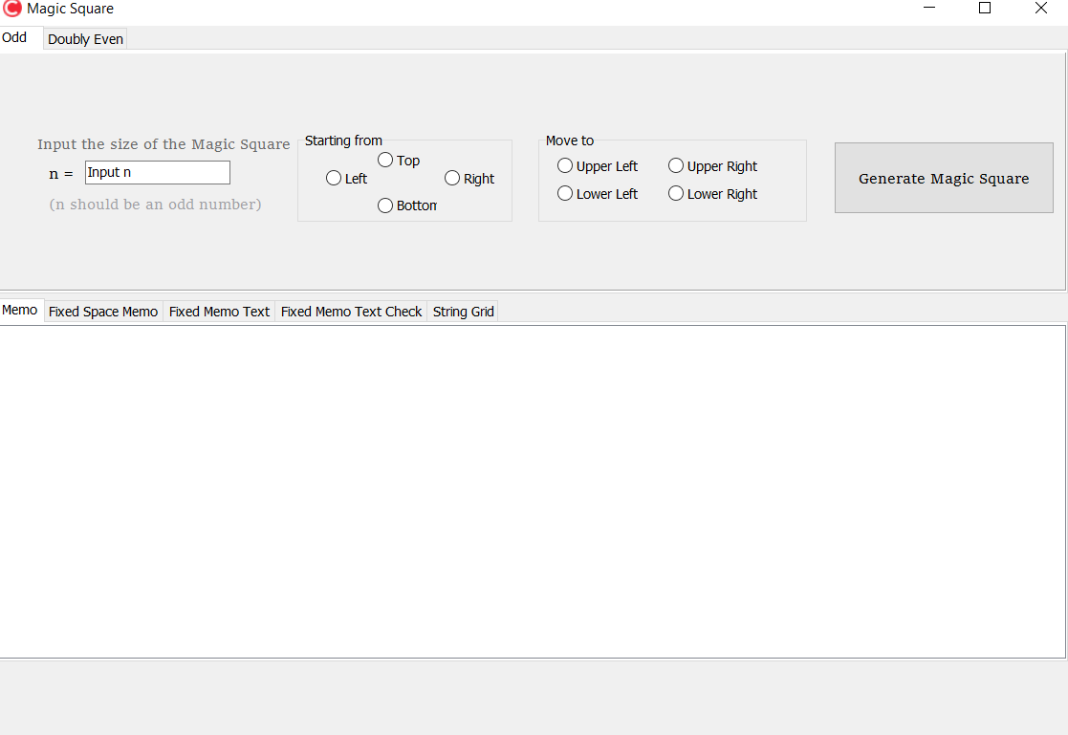
User interface
Input n to set the magic square to n-order. (3 <= n <= 21)
Choose where you want the numbers start to fill in and the moving direction
Press the button to generate the magic square!

Slide 4
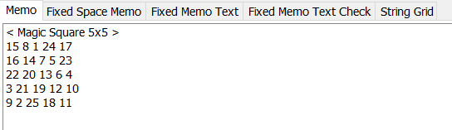
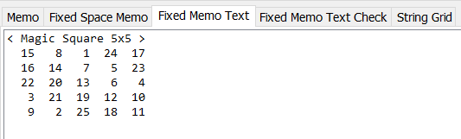


Magic square generated (ex: n = 5)
Magic Square 5x5 printed in Memo
in Fixed Memo Text
Simply print it out
The font Consolas makes the square printed looks very neat
in Fixed Space Memo
with Sum Check
Spaced the number in the Magic Square evenly, but since the characters don’t have the same width, it doesn’t look neat
The sums of each row, column, and the main diagonals are represented.

Slide 5
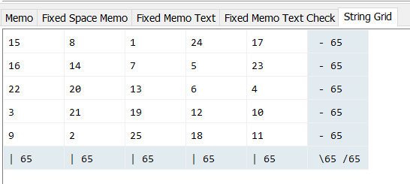
Magic square generated (ex: n = 5)
in StringGrid
Magic Square and the sums are represented in the StringGrid.
Those cells with sums are in light blue.

Slide 6
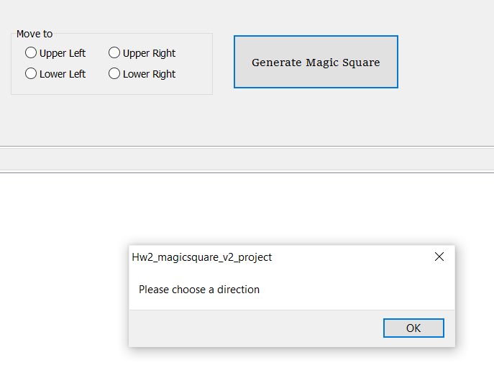
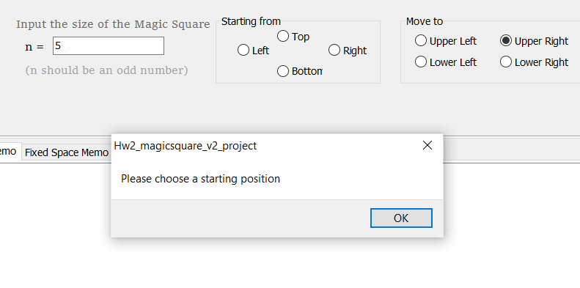
If you forget to check the button

